Slide 1
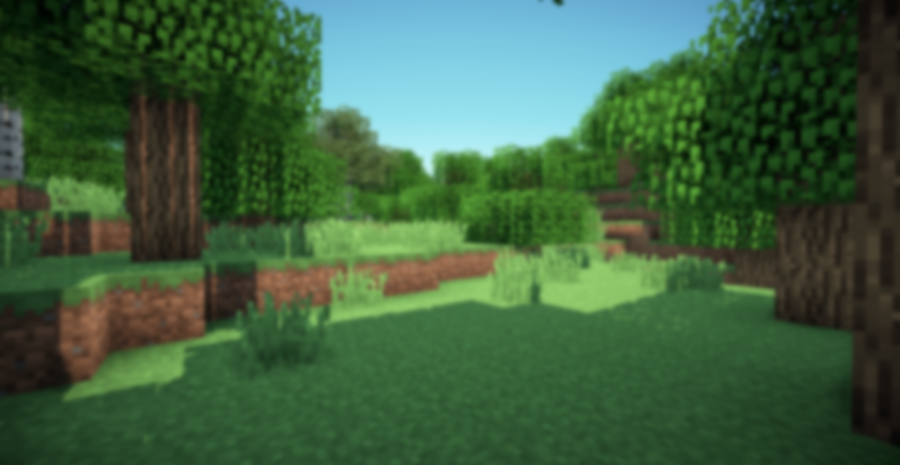

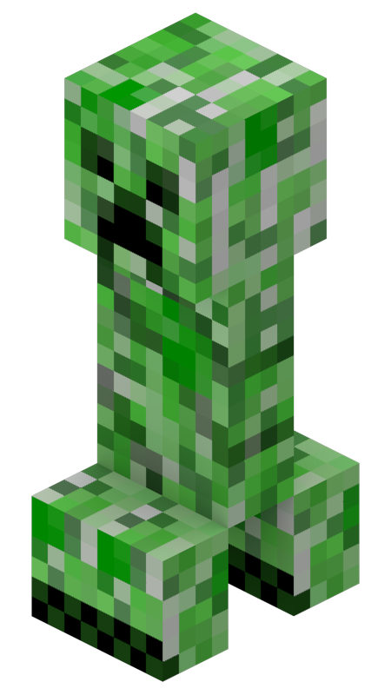
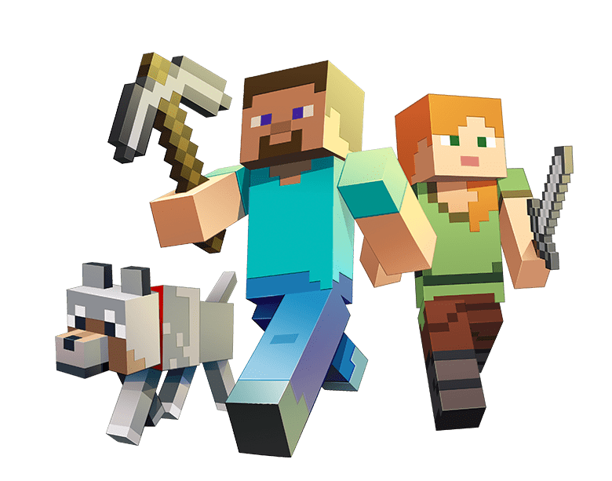
PLUGIN
Start the Presentation
Options.
Quit
MALAGON BAEZA ALAN ADRIAN
6CV2
COMPUTER GRAPHICS

Slide 2
Loading……

Slide 3







MATERIAL

Slide 4
TRANSFORMATIONS
Position
Translate
Rotate
Scale
/cg pos 1
/cg pos 2
/cg pos show
/cg pos reset

Slide 5
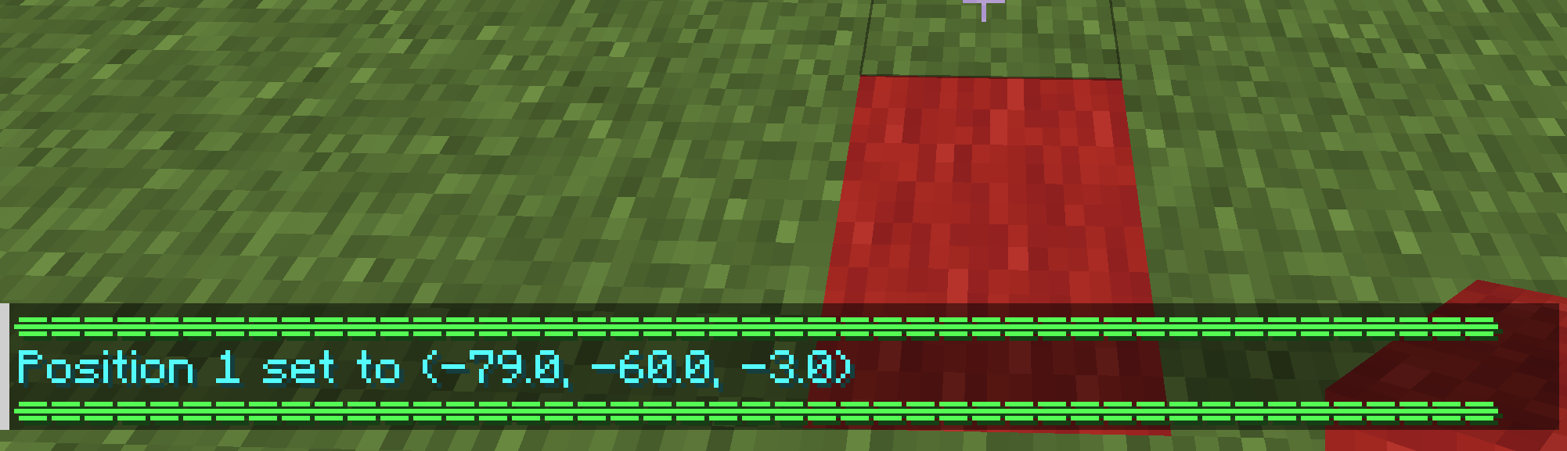

Slide 6
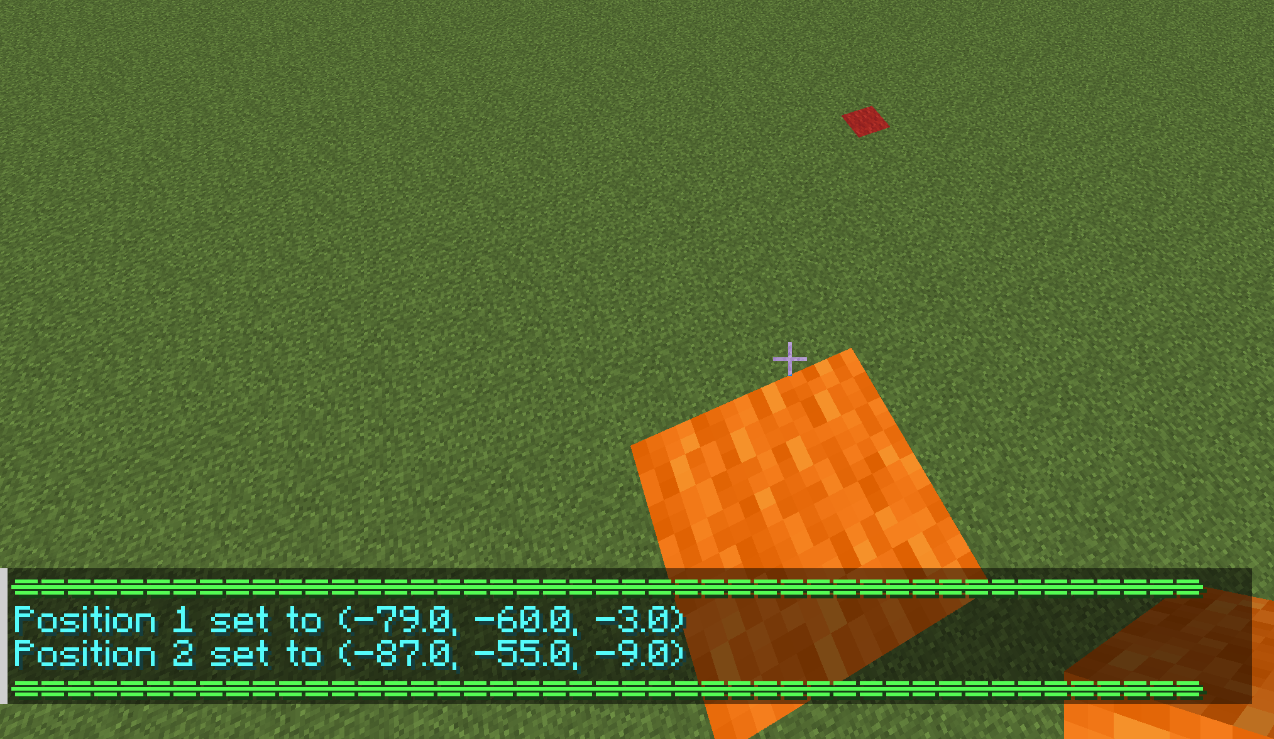

Slide 7
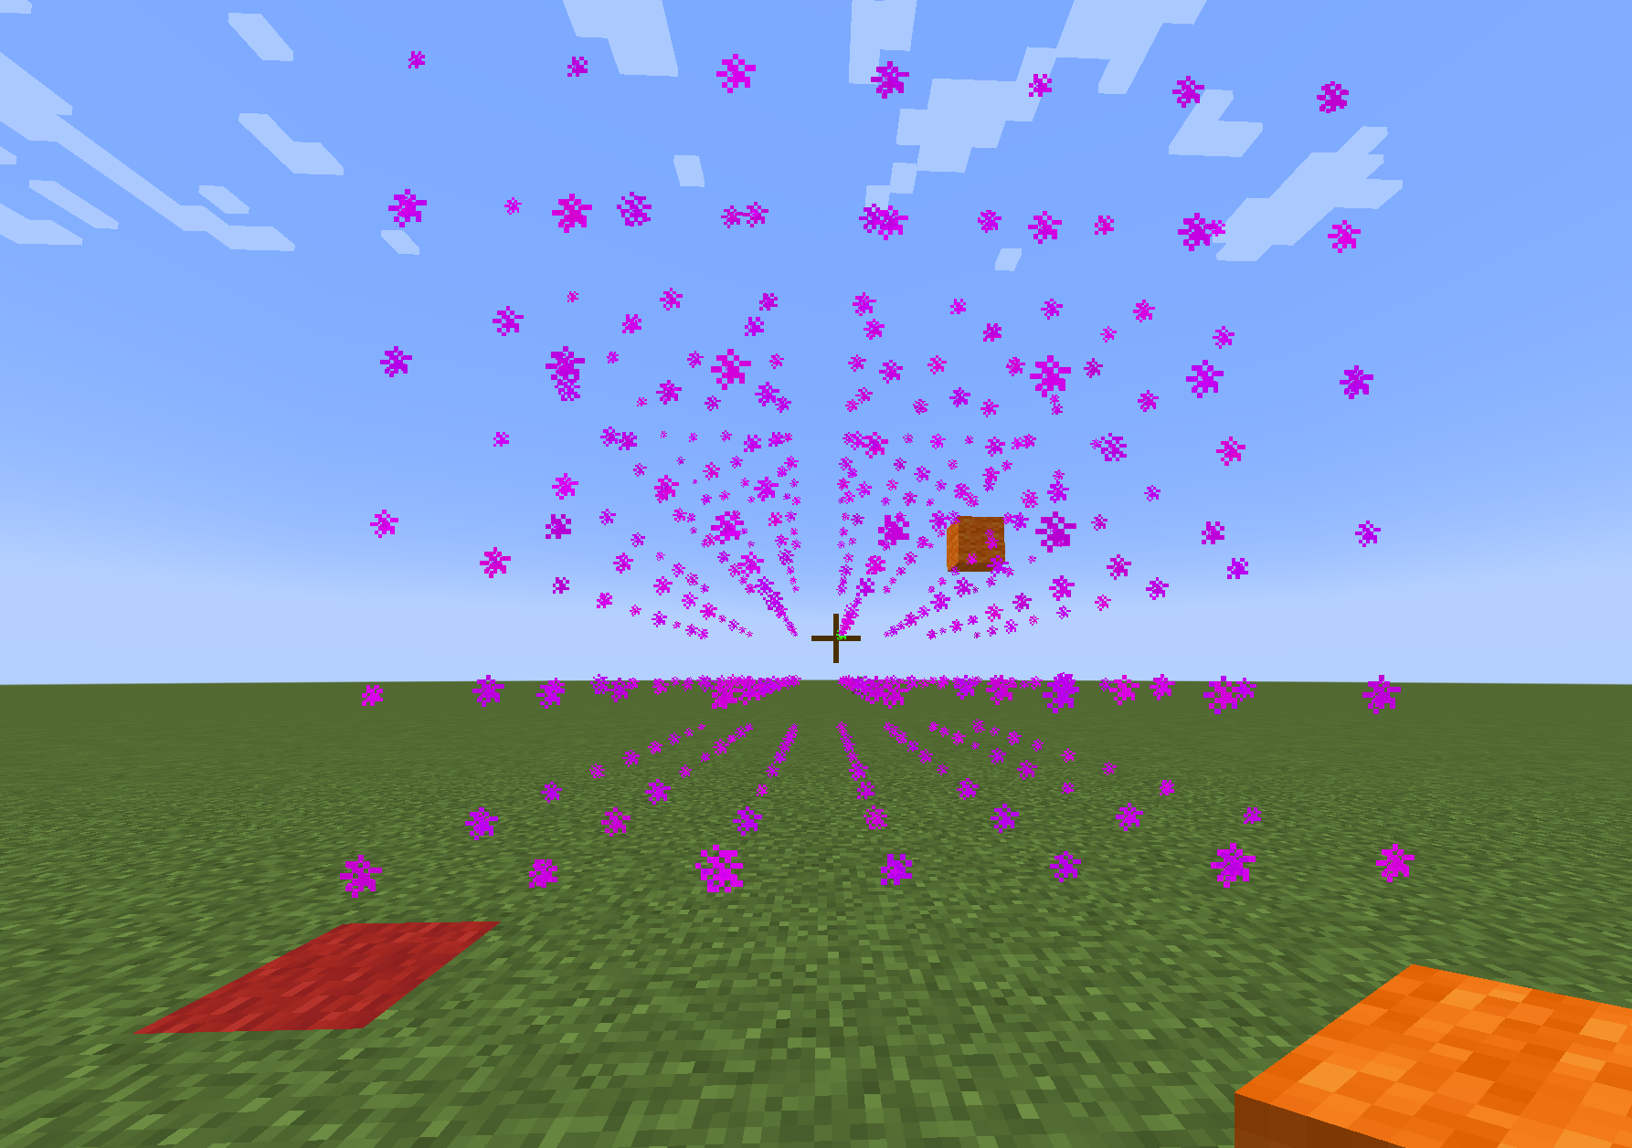

Slide 8
TRANSFORMATIONS
Position
Translate
Rotate
Scale
/cg transform t x y z

Slide 9
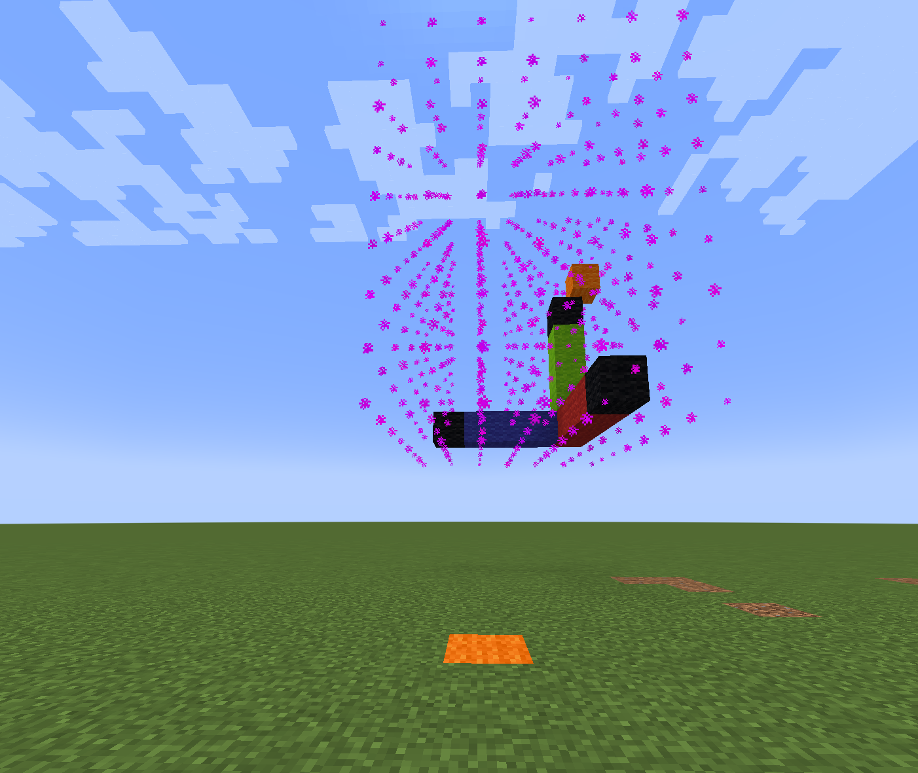

Slide 10
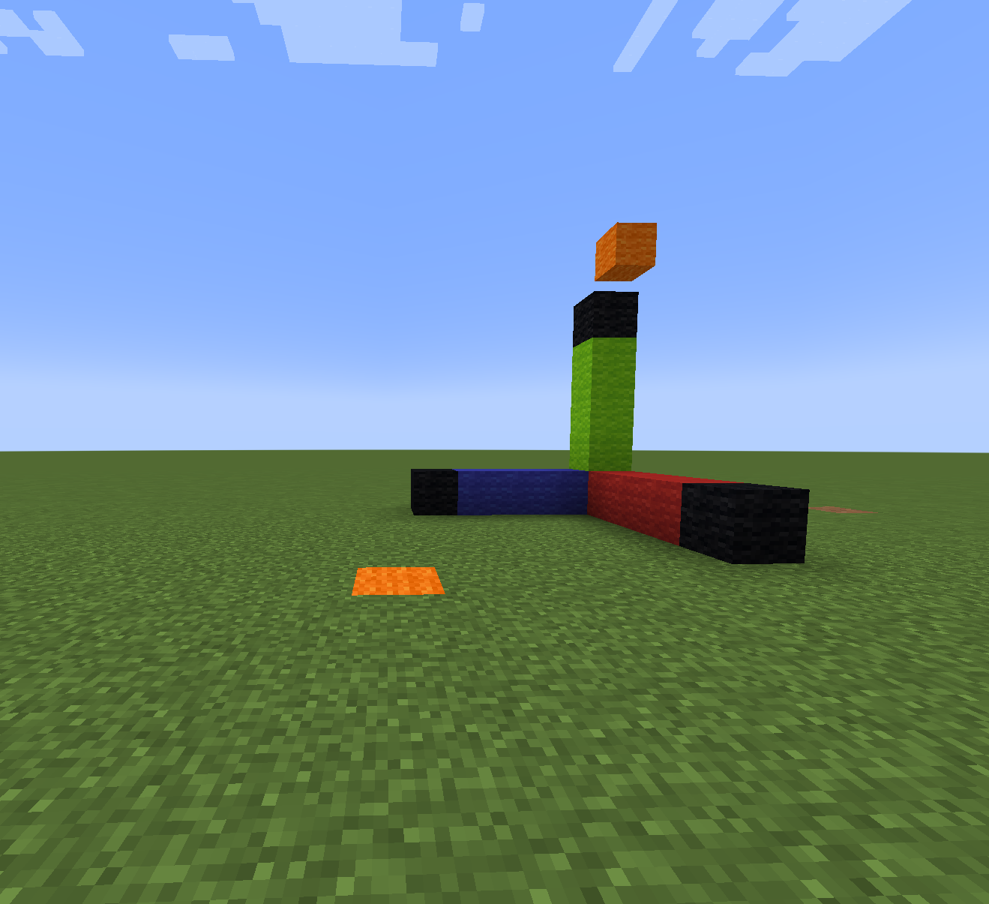

Slide 11
TRANSFORMATIONS
Position
Translate
Rotate
Scale
/cg transform r x y z
/cg transform rh x y z

Slide 12
TRANSFORMATIONS
Position
Translate
Rotate
Scale
/cg transform s x y z

Slide 13
LINES
/cg line TYPE MATERIAL_NAME
TYPES
b: Bresenham Line
d: DDA Line

Slide 14
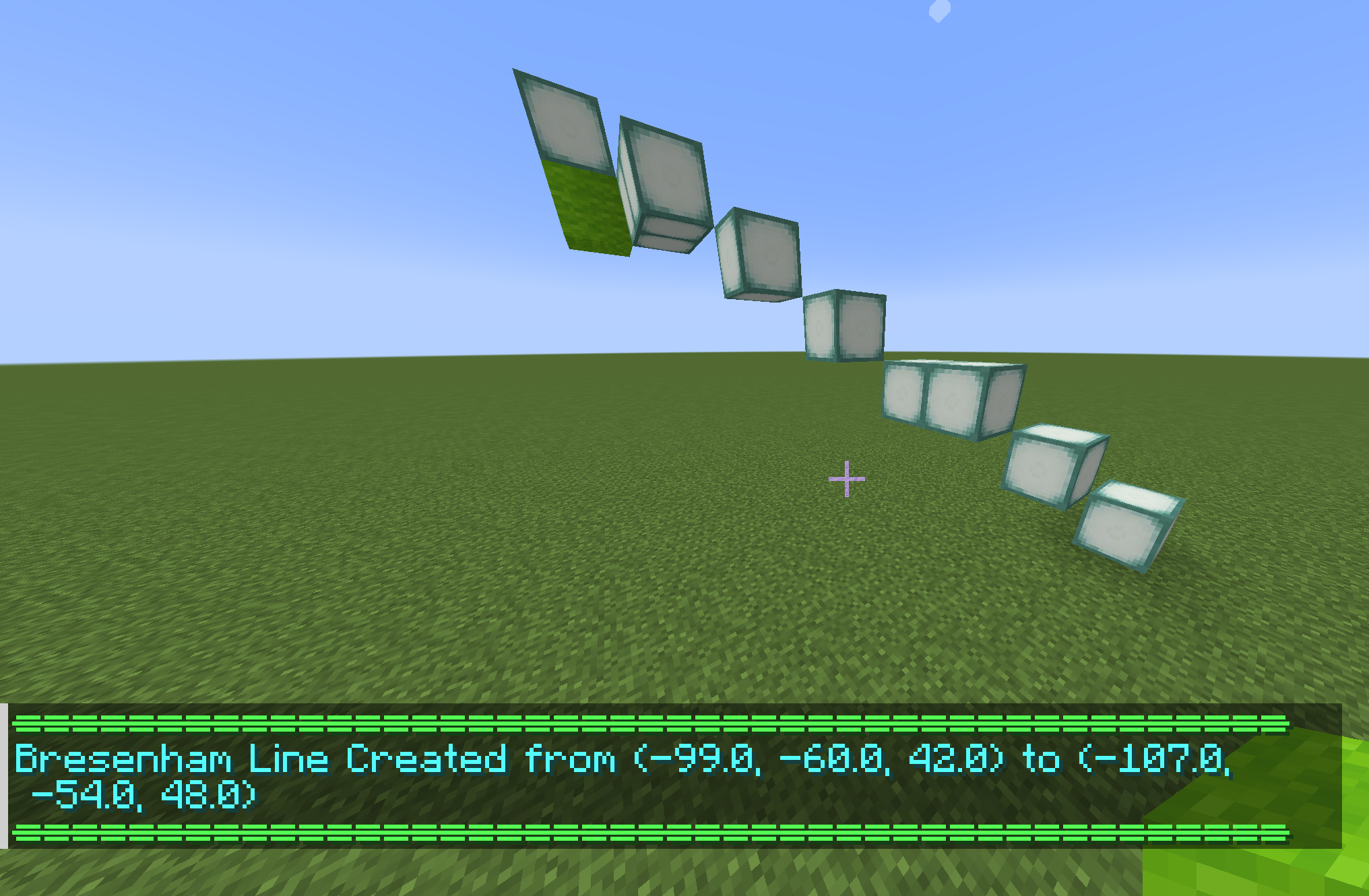

Slide 15
CURVES
/cg curve MATERIAL_NAME T1X T1Y T1Z T2X T2Y T2Z POINTS
HERMITE CURVE
T1X: X value for tangent 1
T1Y: Y value for tangent 1
T1Z: Z value for tangent 1
T2X: X value for tangent 2
T2Y: Y value for tangent 2
T2Z: Z value for tangent 2
POINTS : Number of points to render the curve (More points more smoother). Recommended minimum 10

Slide 16
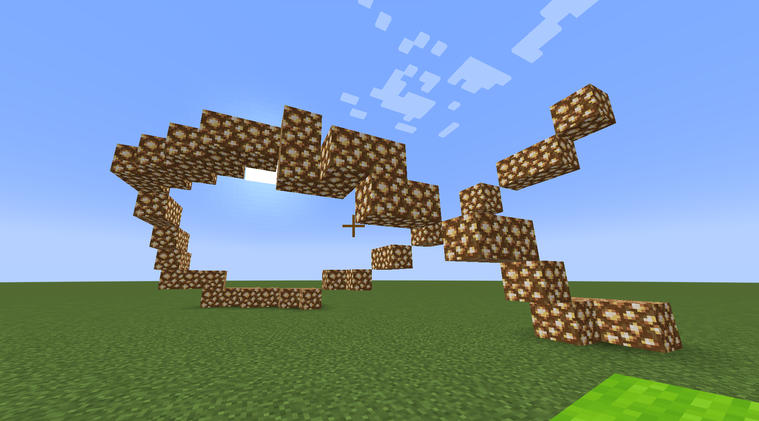

Slide 17
CIRCLES
/cg circle TYPE MATERIAL_NAME RADIUS AXIS
TYPES
b: Bresenham Circle
m: Mid-Point Circle
AXIS
xy/yx
xz/zx
yz/zy

Slide 18
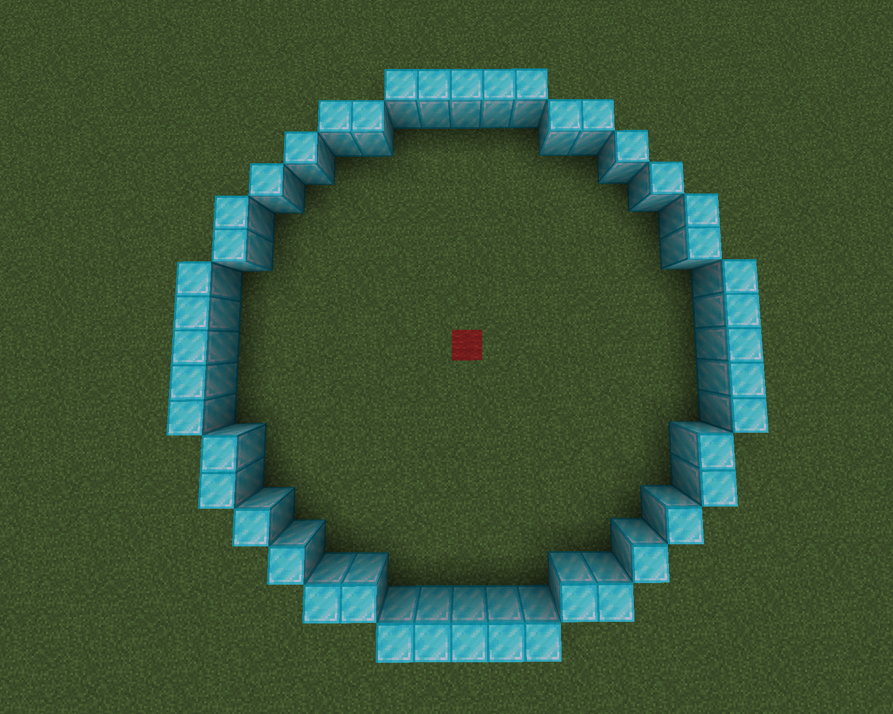

Slide 19
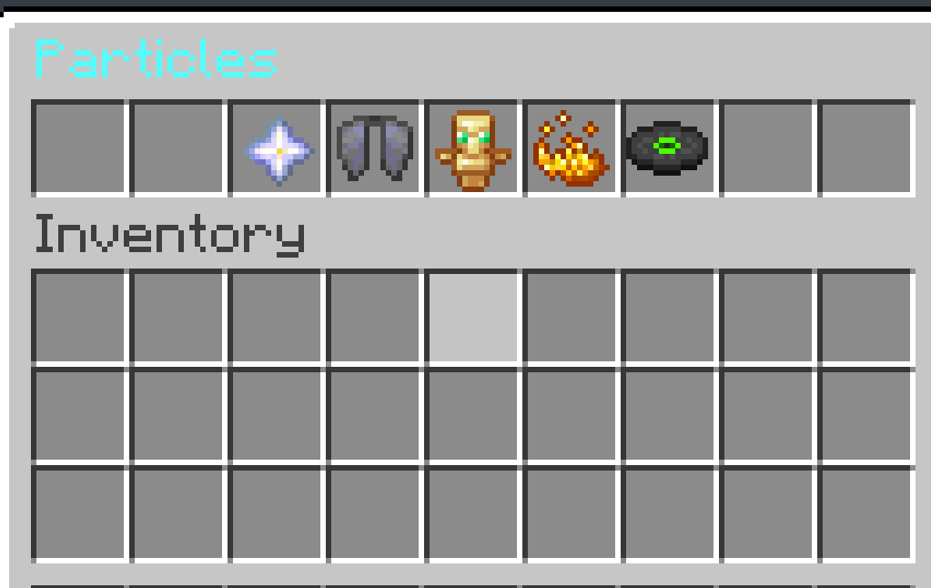
PARTICLES
/cg particles

Slide 20



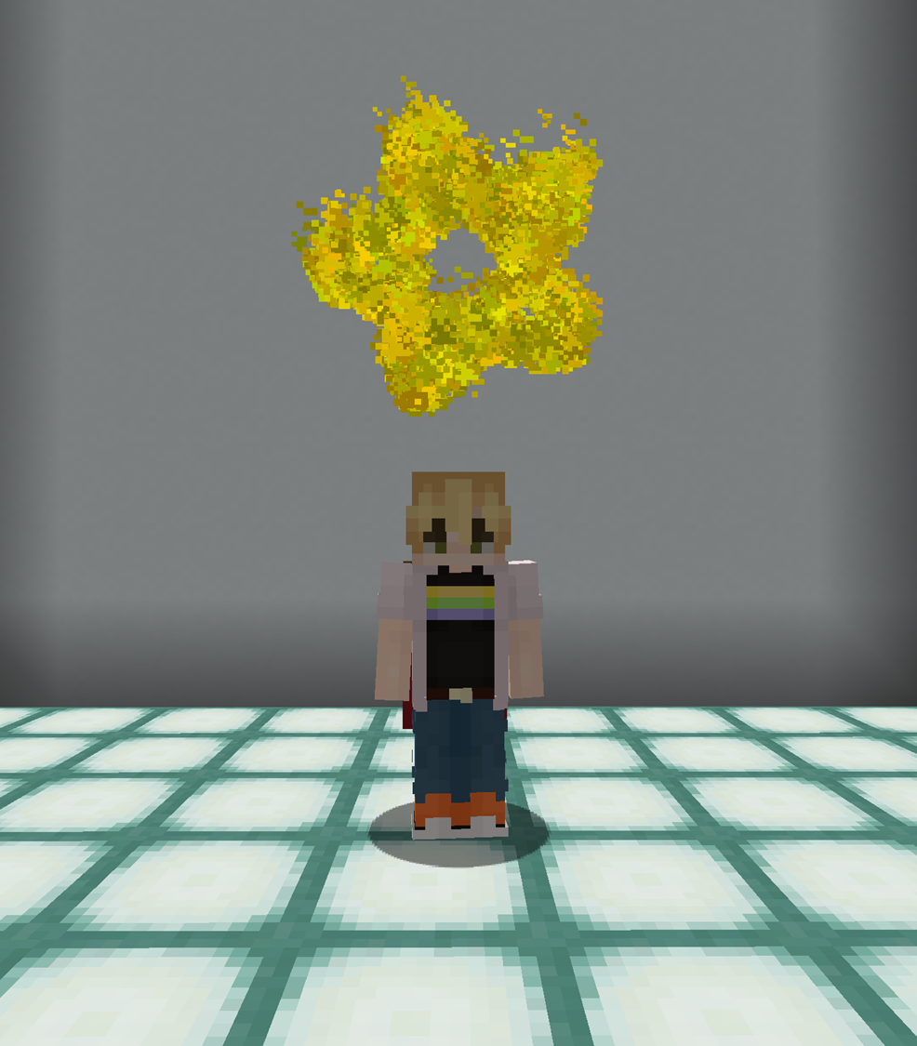
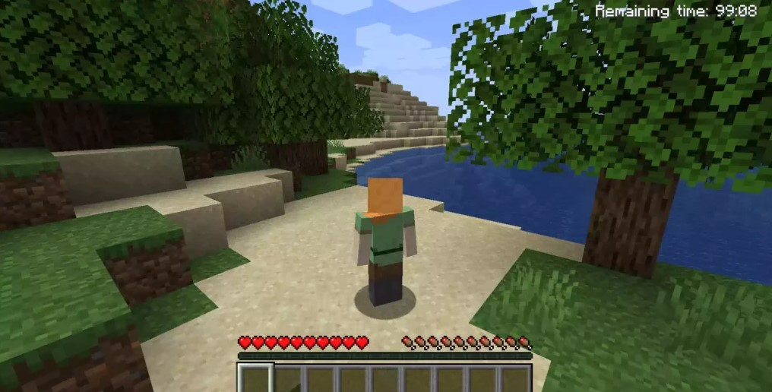
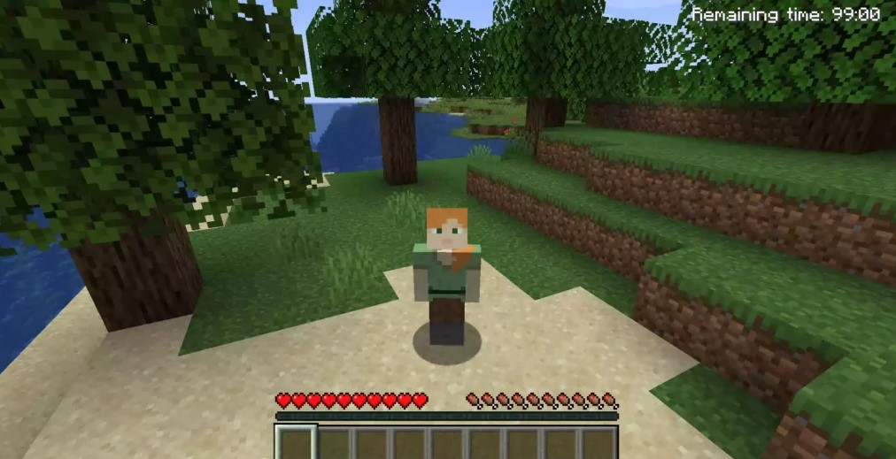
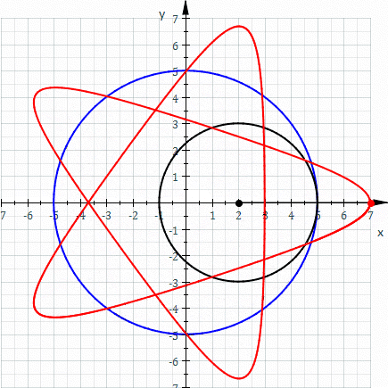
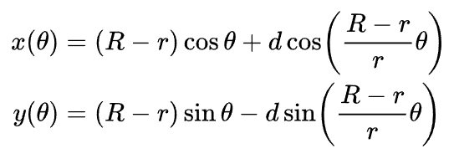
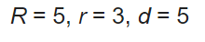
STAR

Slide 21
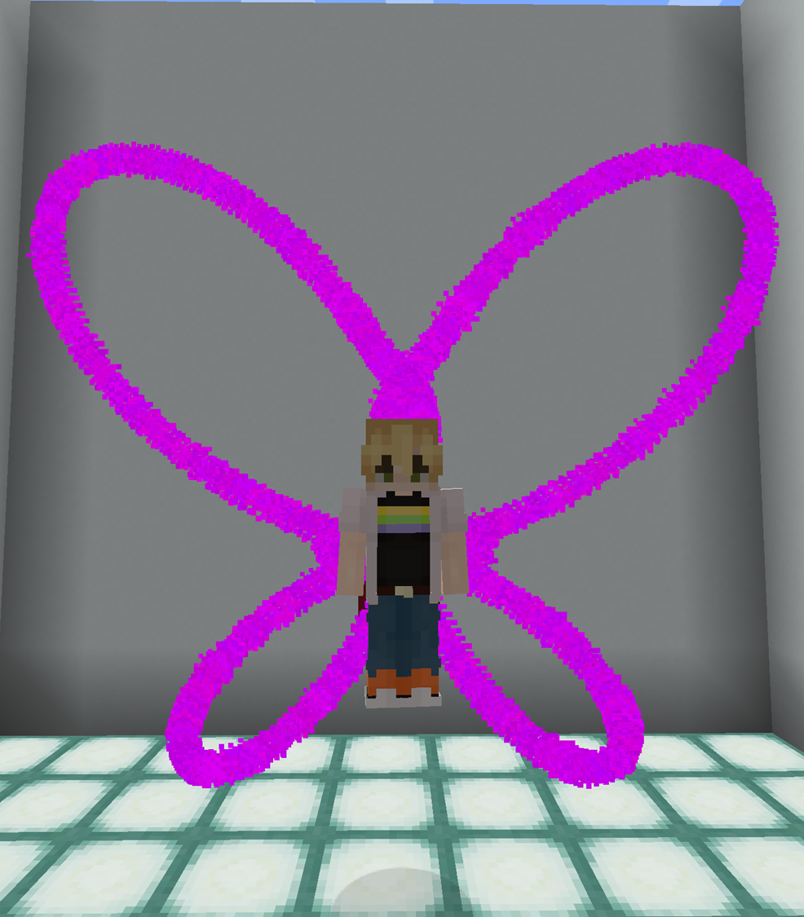
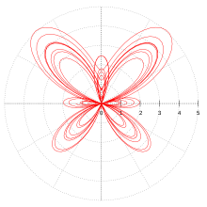
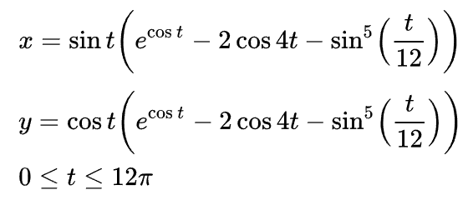
BUTTERFLY WINGS

Slide 22

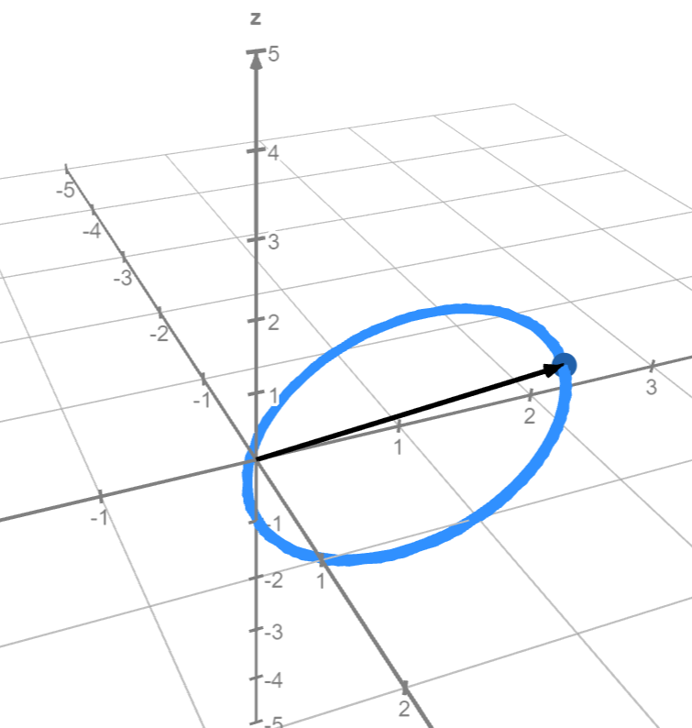
TOTEM TRAILS
X₁ = cos(t)
Y₁ = sin(t)
Z₁ = sin(t)
X₂ = cos(t+π)
Y₂ = sin(t)
Z₂ = sin(t+π)

Slide 23
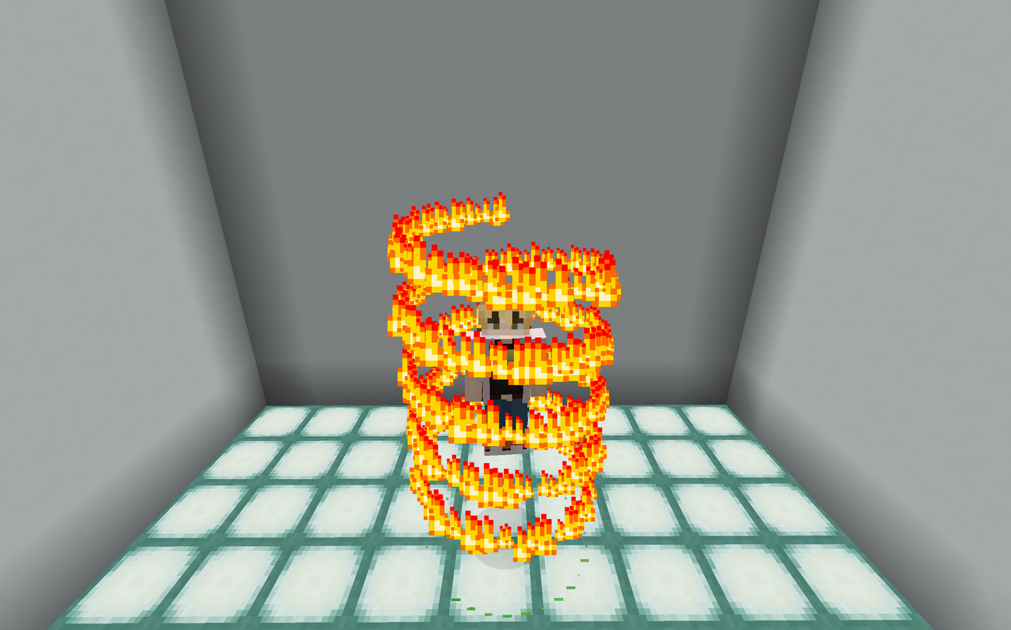
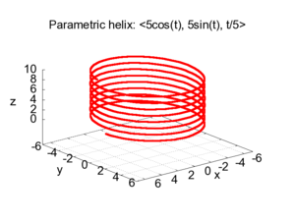
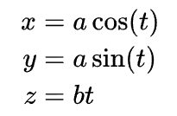
FIRE TRAILS

Slide 24
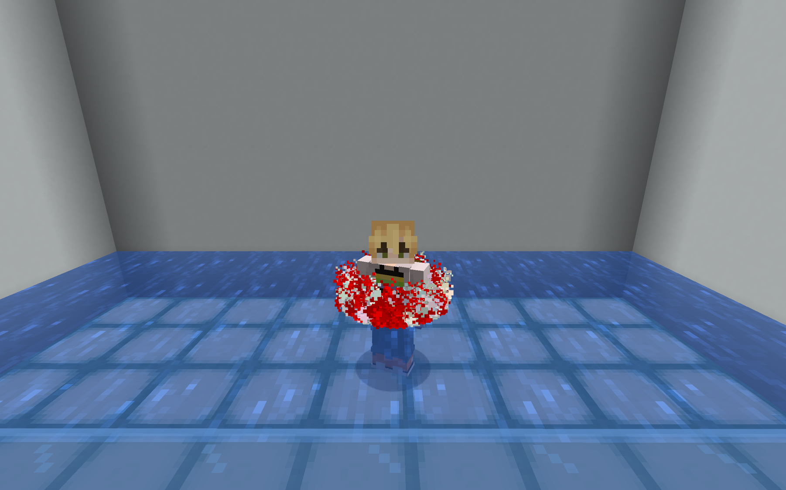
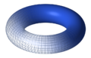
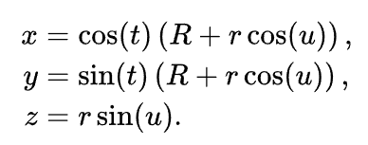
LIFESAVER

Slide 25
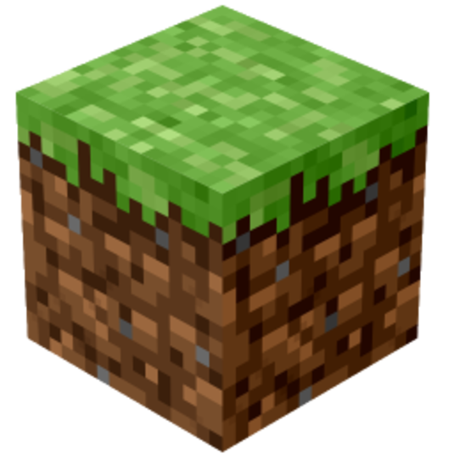
THANK
YOU

